Slide 1
Scrum and AMOS
Dirk Riehle, Univ. Erlangen
AMOS B02
Licensed under CC BY 4.0 International

Slide 2
Reminder on Commits to Repository
Don’t forget to sign-off and declare your co-authors, if any [1]
dirk@host$ git commit -a -m "Fixed problem
> Co-authored-by: Stefan Buchner <stefan.buchner@fau.de>”
> --signoff
[1] For more details, please see the slide deck AMOS B01 on Team and Tools

Slide 3
Agenda
The AMOS process
The team meeting
Meeting preparation
Sprint review
Sprint release
Sprint retrospective
Sprint planning
Bill of materials
Software architecture

Slide 4
1. The AMOS Process

Slide 5
Scrum in Student Projects
Challenges
Widely differing abilities and experiences
Not 100% on project, but in multiple courses
Transient rather than persistent teams
Not available at same place, not at same time
Sometimes extrinsically motivated (grades)
Solutions
Context-aware instantiation of framework
Supporting teaching team, coaching

Slide 6
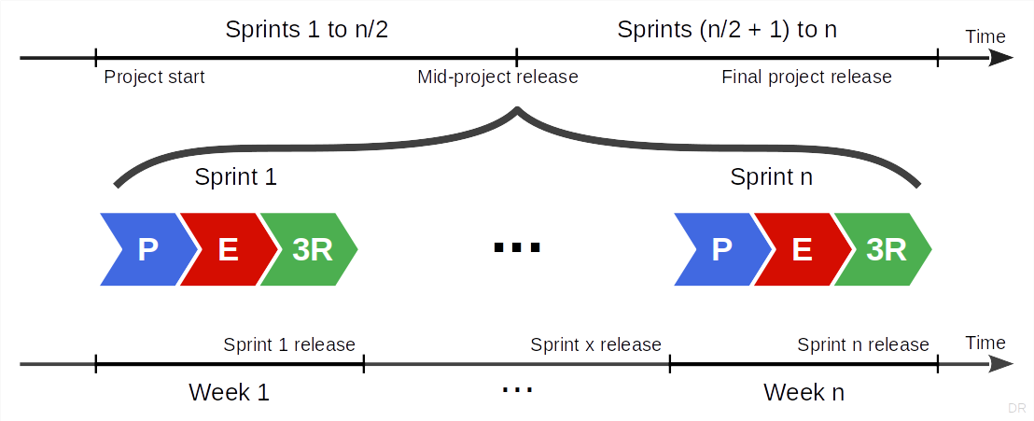
Overall AMOS Project Timeline

Slide 7
Time-boxed Sequence of Releases
A release is
A named identifiable, consistent, and useful snapshot of the software
A sprint release is
A release used to gather feedback from the industry partner to steer the project
A project release is
A release that is deployed to production where it is supposed to perform its job
In the AMOS Project there are two releases (mid-project and final release)

Slide 8
Project Schedule
Please see the Schedule tab of the Course Organization doc

Slide 9
2. The Team Meeting

Slide 10
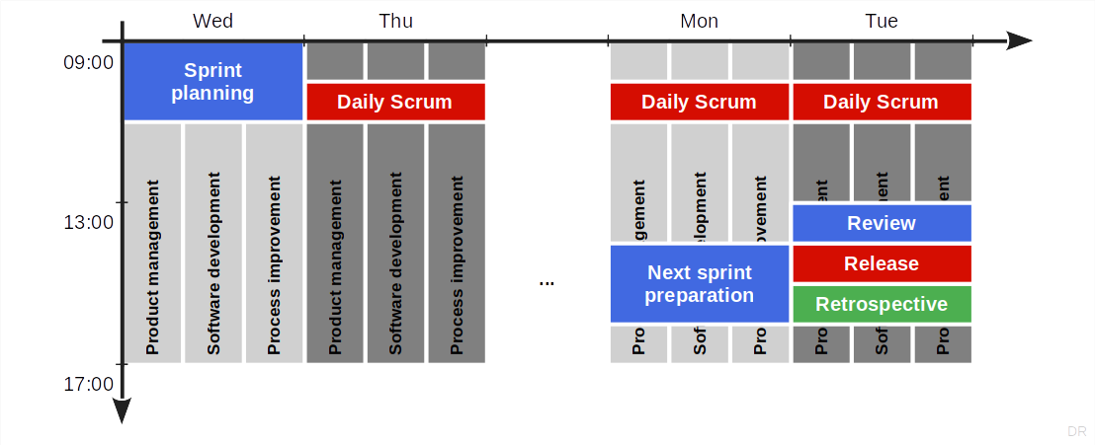
Logical Structure of a Scrum Sprint

Slide 11
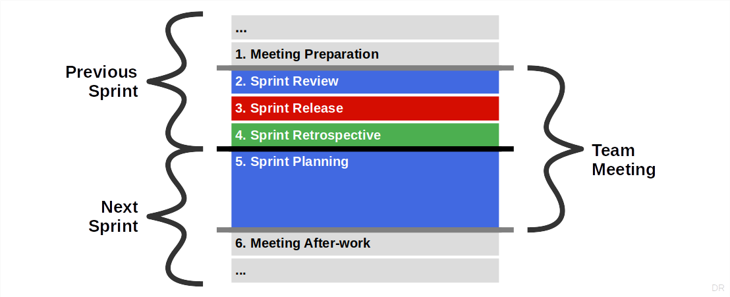
The AMOS Team Meeting

Slide 12
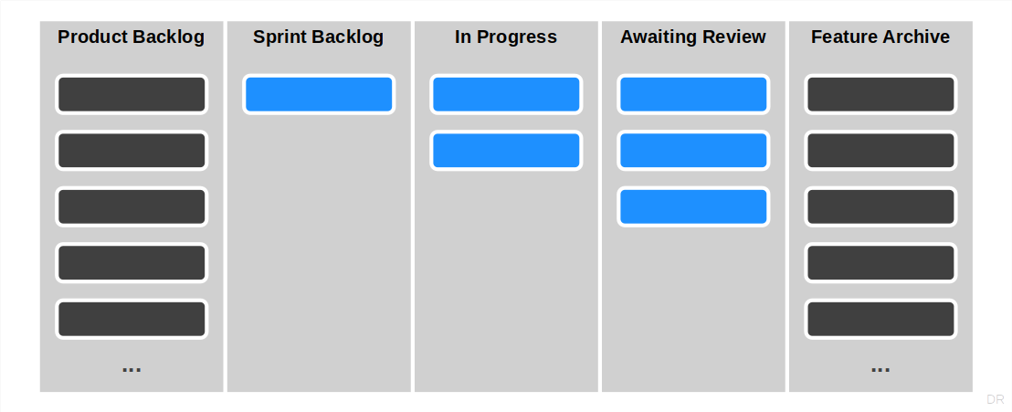
The AMOS Feature Board (Recap)

Slide 13
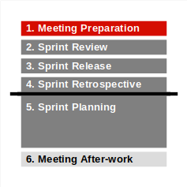
1a. Meeting Preparation
Product owner #1 [1]
Refines backlog [2] in a next sprint preparation meeting
Should include at least one developer (may want to plan this out)
Ensures that the product backlog is ready for sprint planning
There are enough high-quality entries at least for the upcoming sprint
High-quality = meets INVEST criteria, explained later
Product backlog entries may be
New features, bug fixes, and refactorings
[1] Product owner #1 will run the sprint planning in the upcoming team meeting
[2] Backlog refinement is also known as backlog grooming

Slide 14
1b. Meeting Preparation
Release manager
Ensures that a working demo system will be available
Tags release candidate with sprint-xx-release-candidate
Where xx is your sprint number (see deliverables through project schedule)

Slide 15
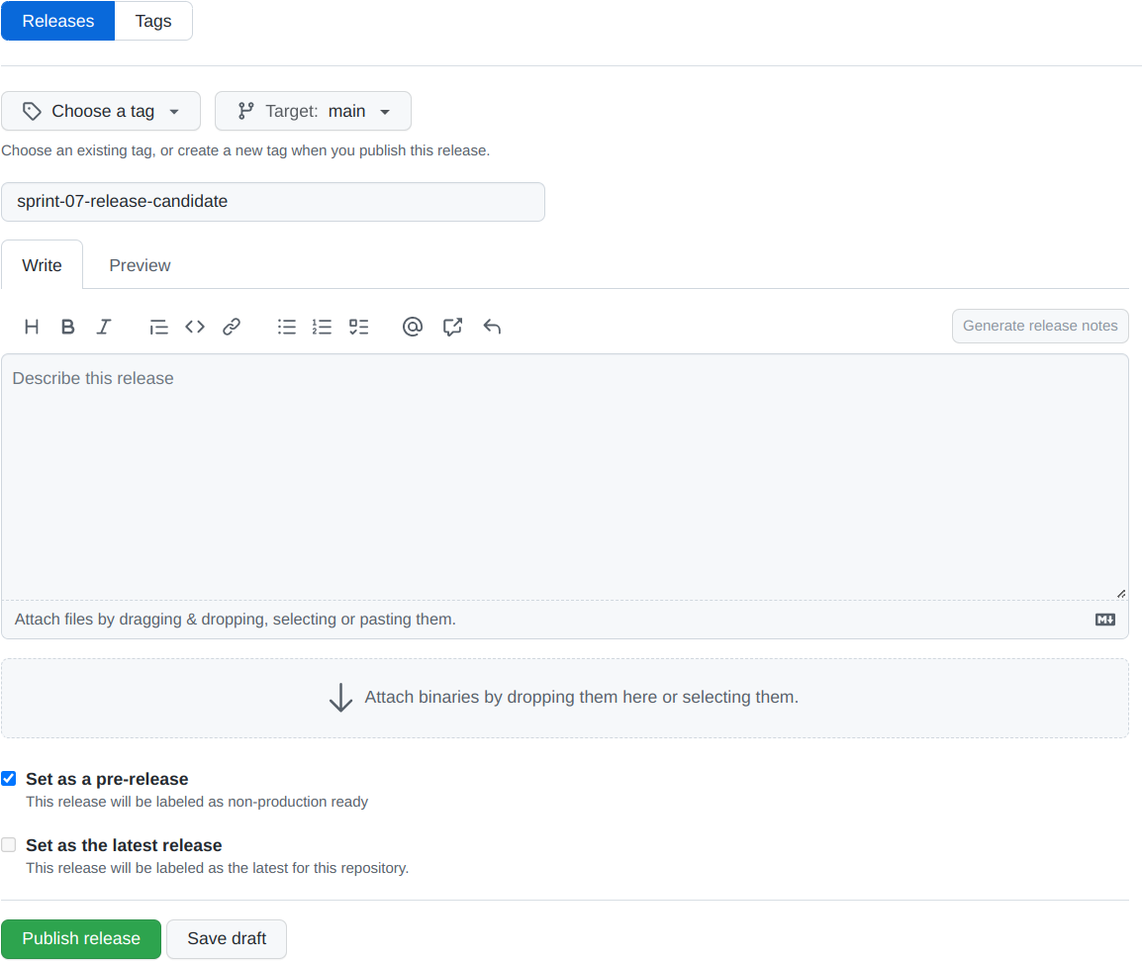
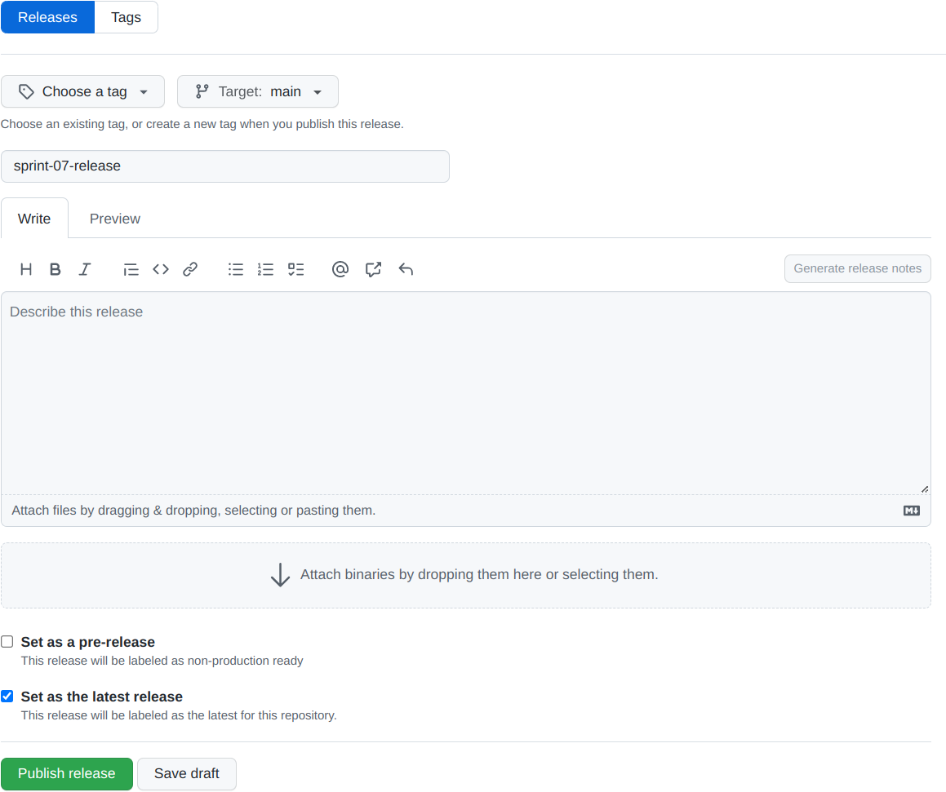
Tagging Release Candidates and Releases
Release candidate
Release [1]
[1] Do not rename release candidates

Slide 16
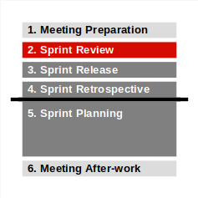
2a. Sprint Review
Release manager
Checks-out fresh code base using release candidate tag
Compiles, builds, and runs tests for release candidate
Deploys release candidate to test environment
The release manager does not run the review

Slide 17
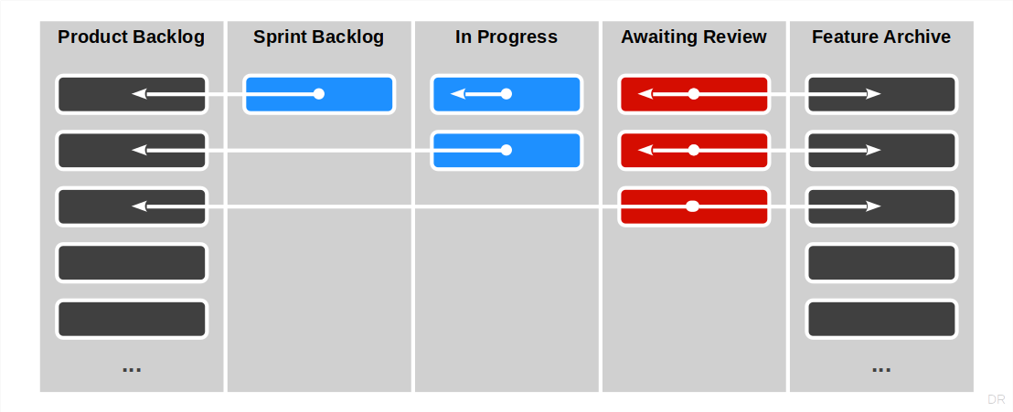
How Backlog Items Move During Sprint Review

Slide 18
2b. Sprint Review
Product owner #2 [1]
Walks through “Awaiting review” column item by item
Asks developer to demo item under review
Insists that developer shows, not just tells
Checks fulfillment of acceptance criteria
Checks fulfillment of definition of done, if required
Checks other criteria incl. logging output for problems
If successfully implemented
Moves item to feature archive
Asks developers about real size, add it to the item
If not successfully implemented
Moves item back to product backlog
[1] Product owner #2 was responsible for the last sprint planning

Slide 19
2c. Sprint Review
Software developer (individually)
Is called upon by product owner for backlog item
Demos backlog item as requested by product owner
Answers questions about item design and implementation
Provides real size as determined after implementation
Only talking, not showing, is not acceptable
The product manager needs to insist on showing not just talking
If a developer only talks, product owner and developer failed

Slide 20
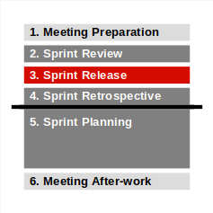
3a. Sprint Release
Product owner #2
Decides whether release candidate should be released
Only in case of significant regression should you not release
Later in the course you will use a definition of done
Specifics depend on type of release
Consults with software developers if necessary

Slide 21
3b. Sprint Release
Release manager
If the release candidate is to be released
Tags release with sprint-xx-release where xx is your sprint number
Deploys sprint release to operations environment
If there is a change log (optional)
Updates change log with release information

Slide 22
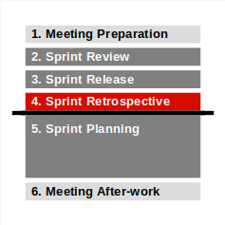
4a. Sprint Retrospective
Scrum Master
Reviews this sprint’s impediments and improvements
Reports on progress
Reviews remaining problems
Performs roll call, asks everyone individually
What has gone well?
What hasn’t gone well?
What can we do better?
Puts new impediments and improvements into imp-squared backlog

Slide 23
4b. Sprint Retrospective
Everyone
Answers to happiness index

Slide 24
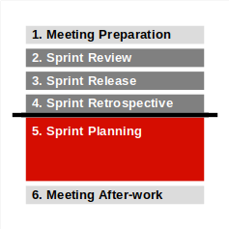
5a. Sprint Planning
Product owner #1
Reprioritizes product backlog items, if necessary, on-the-fly
Works through top-prioritized backlog items one-by-one
For each product backlog item,
explains it,
asks developers to estimate and commit
You are finished, if the team does not want to take on more backlog items

Slide 25
5b. Sprint Planning
Software developers (as team)
Estimate size of each backlog item using planning poker
After planning, commit to backlog items in sprint backlog

Slide 26
Story Points
Story points
Is an arbitrary numeric measure of size of a given backlog item
Properties
Is a measure of size, not of effort or duration
Measured in non-linear increments, forcing choice
Is socially agreed upon, depends on team estimation history
Is independent of a particular person (and their skills)
Is mapped to time using the team's velocity (development speed)
Points | Meaning
0 | No size
1 | Trivial size
2 | Small size
3 | Medium size
5 | Large size
8 | Very large size
13 | Too large (size)

Slide 27
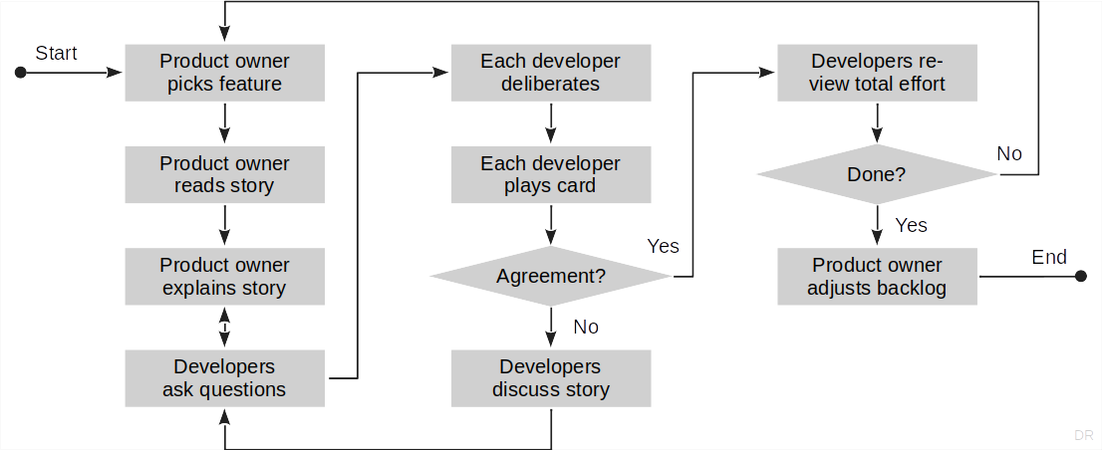
Sprint Planning with Planning Poker [1]
[1] A simple planning poker cards replacement can be found in your planning document

Slide 28
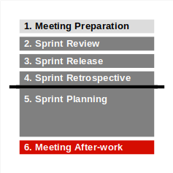
6a. Meeting After-work
Product owner #2
Updates planning document to consistent state
Cleans up product and sprint backlog
Ensures feature archive is current

Slide 29
6b. Meeting After-work
Software developer (as team)
Plan programming tasks (1 feature = 1+ tasks)
Agree on which developer(s) work(s) on which tasks
If pair programming, ensure you document the pair

Slide 30
6c. Meeting After-work
Scrum Master
Works on impediments and improvements during sprint
Documents resolutions in imp-squared backlog

Slide 31
An Efficient Team Meeting Takes 90 Min. (or Less)
# | Section | Duration
1 | Meeting preparation | -
2 | Sprint review | ~35%
3 | Sprint release | ~5%
4 | Sprint retrospective | ~20%
5 | Sprint planning | ~40%
6 | Meeting after-work | -

Slide 32
3. Bill of Materials

Slide 33
Bill of Materials [1]
A bill of materials (of some artifact) is
A linear list of materials (the parts) constituting the artifact (the whole)
A bill of materials can contain any kind of material
Not just software
If purely software, the bill of materials is also called the
Software bill of materials (SBOM)
[1] German: Stückliste

Slide 34
Software Bill of Materials (SBOM)
For each dependency, provide this (recommended, not required) information
Field | Name | Example
1 | Context | com.google.code.gson
2 | Name | gson
3 | Version | 2.3.1
4 | License | Apache-2.0
5 | Comment (optional) | Pulled from Maven Central

Slide 35
Regular Deliverable: Software Bill of Materials
Please initialize your software bill of materials and keep it up-to-date
You can limit this to your first-level dependencies
You can use a tool, e.g. a build tool plugin to generate the SBOM
Please update every time you change your dependencies

Slide 36
4. Software Architecture

Slide 37
Agile Architecture?!
Agile methods eschew detailed planning
The proof of the software is in the feedback of the customer
Software architecture is the overall design of a system
Including static (structural) and dynamic aspects
Covering everything of wide impact to the system
Ignoring everything with limited (localized) impact
Agile software architecture is software architecture that
Emerges from risk-adjusted planning / visibility
Delays architectural investment to the last minute

Slide 38
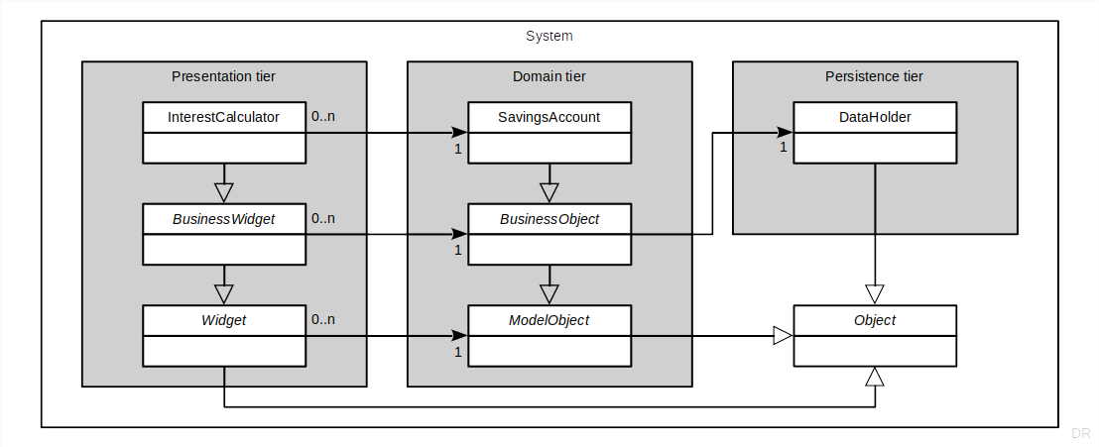
Runtime Architecture

Slide 39
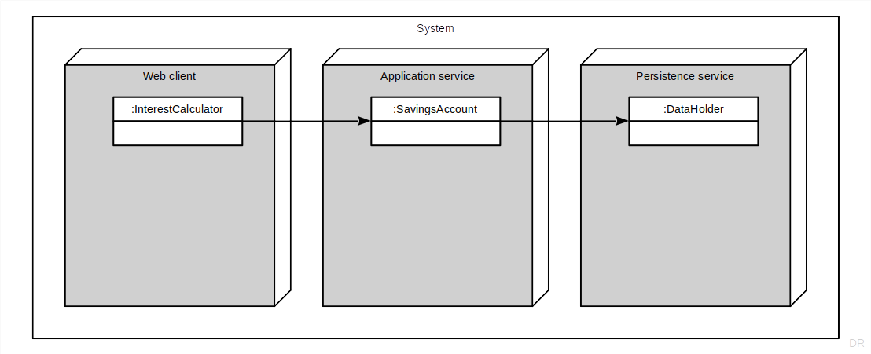
Objects at Runtime

Slide 40
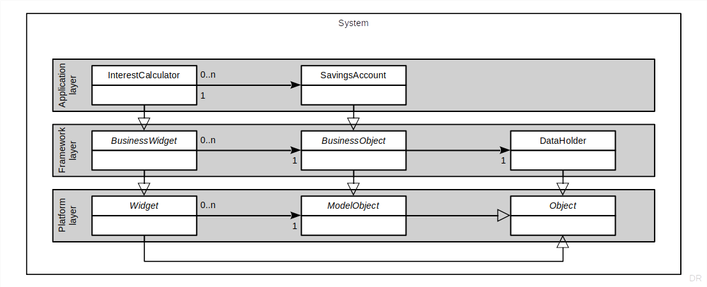
Code Organization

Slide 41
One-time Deliverable: Architecture Description
Provide a description of the initial planned architecture including (at a minimum)
The runtime architecture
The (static) code organization
The tech stack you are building on
Feel free at the end of the project to review planning with reality

Slide 42
Summary
The AMOS process
The team meeting
Meeting preparation
Sprint review
Sprint release
Sprint retrospective
Sprint planning
Bill of materials
Software architecture

Slide 43
Thank you! Any questions?
dirk.riehle@fau.de – https://oss.cs.fau.de
dirk@riehle.org – https://dirkriehle.com – @dirkriehle

Slide 44
Legal Notices
License
Licensed under the CC BY 4.0 International license
Copyright
© Copyright 2009, 2024 Dirk Riehle, some rights reserved

